Slide 1

Monte-Carlo simulations of thermal neutron filter and neutron guide system for REVERANS reflectometer
Peter Konik
Petersburg Nuclear Physics Institute, Gatchina, Russia
Saint-Petersburg State University, Saint-Petersburg, Russia

Slide 2
Contents
Our facilities
REVERANS reflectometer
Thermal neutron filter
Neutron guide
Current work
Conclusion

Slide 3
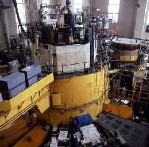
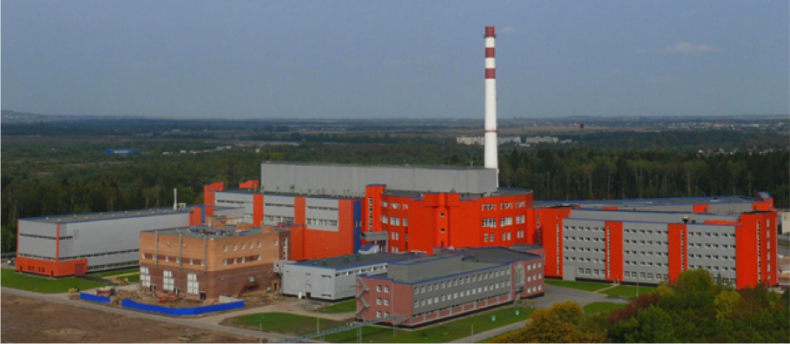
Our facilities
WWR-M
Operational since 1959
18 MWt
3·10¹⁴ n/cm²·s
PIK
First critical 2011
100 MWt
4.5·10¹⁵ n/cm²·s
3 cold neutron sources
1 hot neutron source
50 instruments

Slide 4
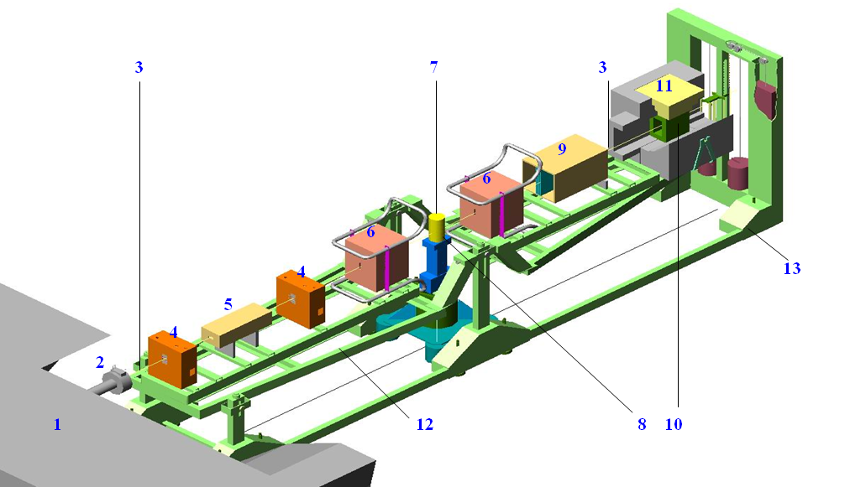
REVERANS reflectometer
Vertical scattering plane
Both free and interface surfaces
Phase boundaries
Liquids, solutions, suspensions, colloid solutions of nanoparticles, liquid crystals

Slide 5
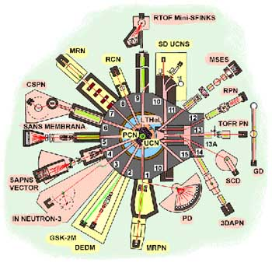
REVERANS at WWR-M
+ more neutrons
- direct view

Slide 6
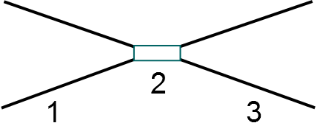

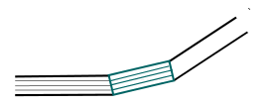


Thermal neutron filter

Slide 7
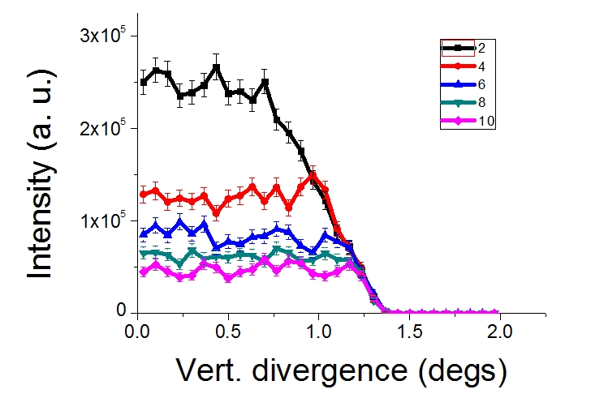
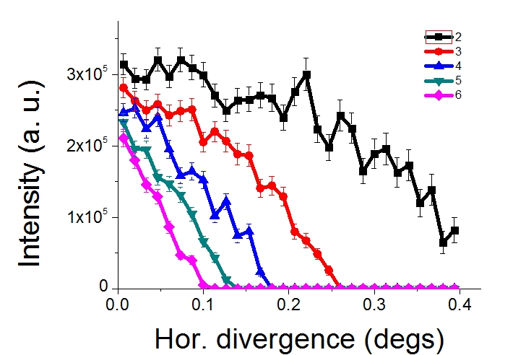
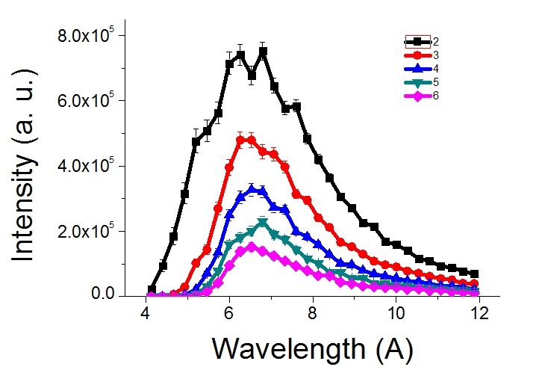
MC simulations
Entry collimator length | 1.77 m
Exit collimator length | 1.5 m
Mirror coating | m = 2.25
Mirror width | 0.38 mm
Critical wavelength | 6 Å
Collimator and filter width | 28 mm
Entry window height | 80 mm
Exit window height | 13.3 mm
Number of collimator channels | 3

Slide 8
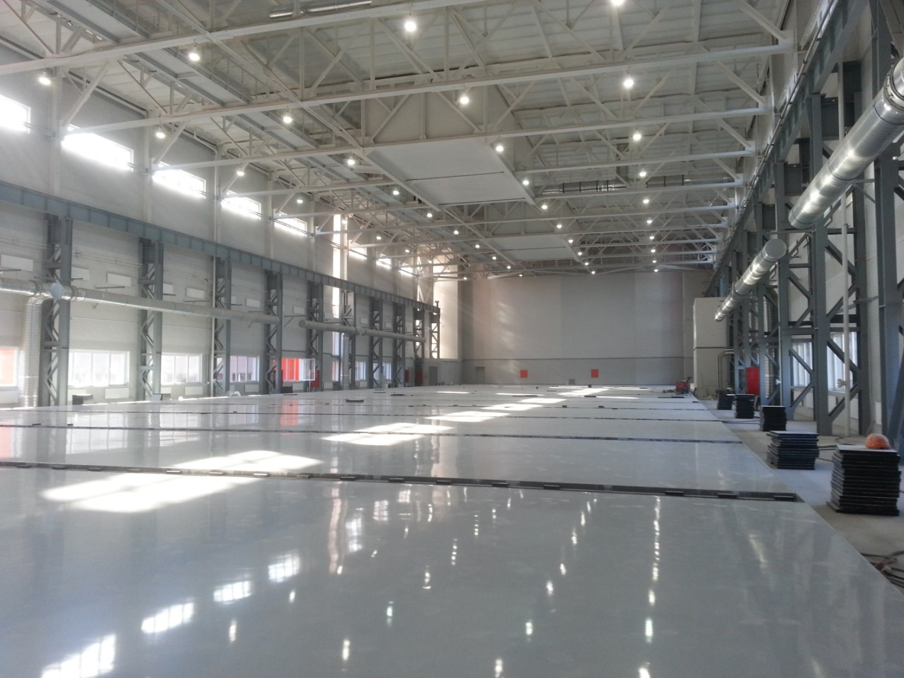
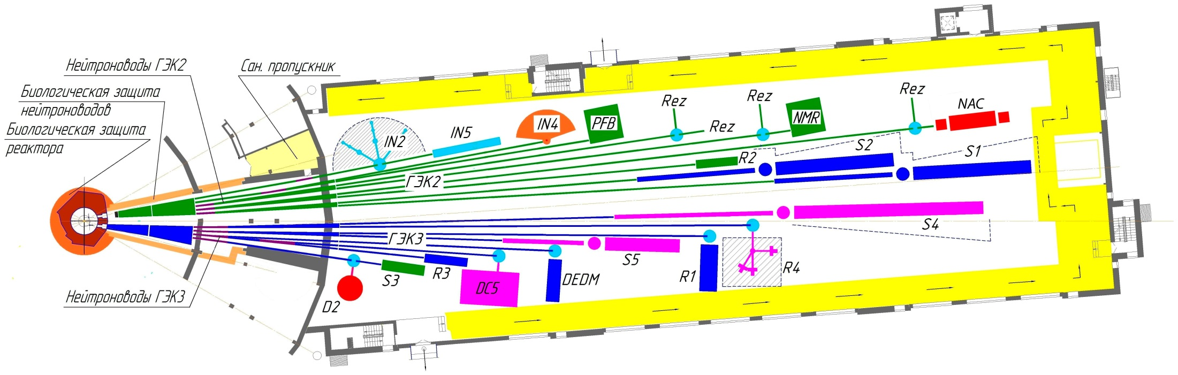
PIK neutron guide hall

Slide 9
Guide simulations

Slide 10
Guide simulations

Slide 11
Guide simulations
Divergence!

Slide 12
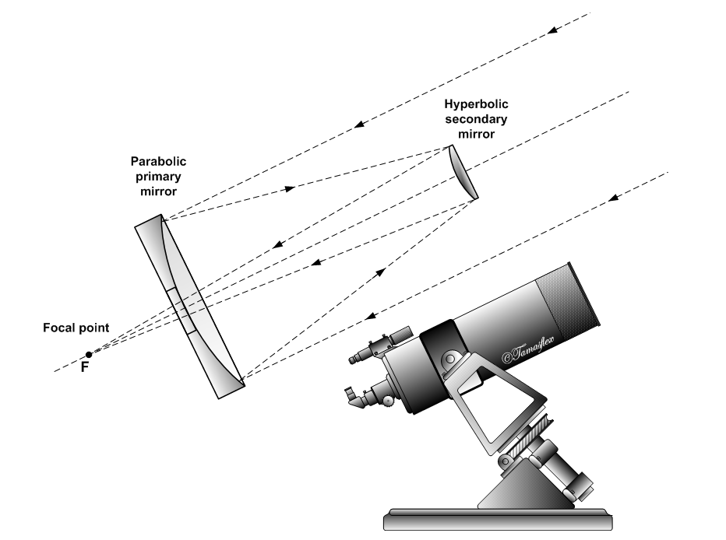
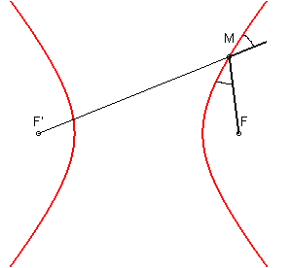
Hyperbolic mirror (i)
Cassegrain reflector

Slide 13
Hyperbolic mirror (ii)

Slide 14
Conclusion
MC simulation allow to:
Find optimal parameters
Handle complex geometry guides
Simulate new optical elements

Slide 15

Acknowledgement
Dr. Evgeny Moskvin
Vladimir Zabenkin
Dr. Alexander Ioffe

Slide 16
Thank you for attention!

